Slide 1
Longest Path
By Arman Saadat and Zane Metz

Slide 2
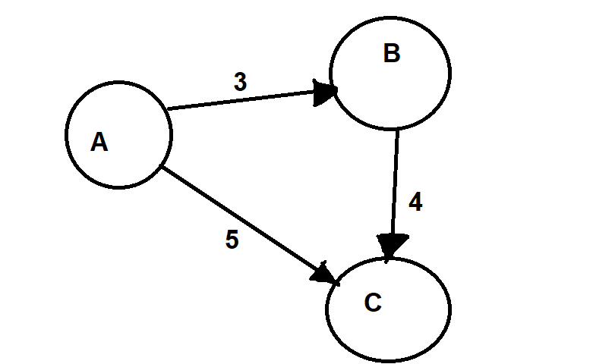
The Problem
Decision Problem:
Whether or not a simple path (distinct edges and vertices) exists of at least some given length in the graph.
Length can be either number of edges or the total sum of the weights of the edges.
Optimization Problem:
What is the longest simple path (distinct edges and vertices) in the graph?
Example Input:
3 3
a b 3
b c 4
a c 5
Example Output:
7
a b c

Slide 3
Why is Longest Path Important?
Critical Path Analysis (CPA) to help manage scheduling of complex projects.
Construction of a directed acyclic graph
Vertices represent project milestones
Edges represent activities that must be performed after one milestone and before another
Each edge is weighted by an estimate of the amount of time the corresponding activity will take to complete.
The longest path from the first milestone to the last one is the critical path, which describes the total time for completing the project
Layered graph drawing
Directed acyclic graphs
For each vertex V in graph, assign V to a layer whose number is the length of the longest path ending at V.
Results in a layer assignment of the graph with the minimum number of layers

Slide 4
Polynomial Verification Certification - Decision Problem
Assume a theoretical Longest Path Solver generates a path of at least length K.
Verification: Do a Depth or Breadth First Search on the start vertex of the path to ensure that the end vertex can be reached via a simple path.

Slide 5
Reduction
The Hamiltonian Path Problem can be reduced to Longest Path
Hamiltonian Path Problem:
Does a path that visits each vertex exactly once exist in a graph (undirected or directed)?
Assume you have a Graph, G
A graph has a Hamiltonian Path IFF its Longest Path has n-1 edges,
where n = total number of vertices in G.
Solve the Longest Path problem for at least K edges.
where K = n - 1
The Longest Path calculated above must be a Hamiltonian Path, as it visits every vertex within G.

Slide 6
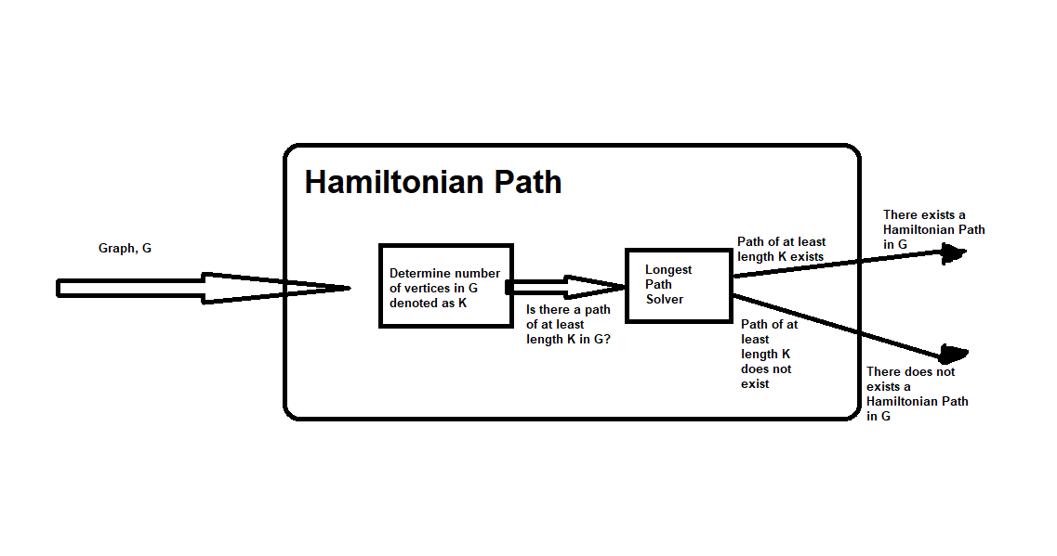
Reduction

Slide 7
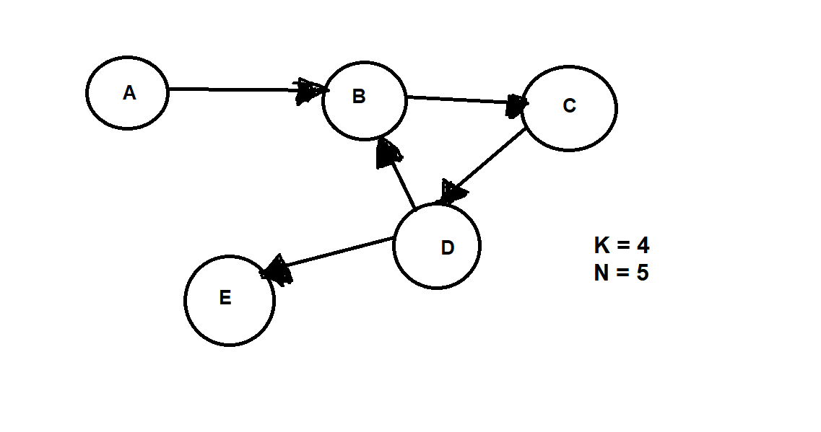
Reduction

Slide 8
Why taking the negative weights on all the edges and using bellman-ford does not work
Bellman-Ford does not find the cheapest path when the graph has a negative weight cycle.
If we were to take a Graph that contains a cycle, negate the edge weights, and provide it to Bellman-Ford, Bellman-Ford would not provide the correct answer.
However, the Longest Path Problem can be solved in polynomial time in Directed Acyclic Graphs using topological sort.

Slide 9
Code Explanation 1
Generate a list of all permutations of nodes in the graph
Example Input:
3 3
a b 3
b c 4
a c 5
Example output:
7
a b c
Permutations:
[('a', 'b', 'c'), ('a', 'c', 'b'), ('b', 'a', 'c'), ('b', 'c', 'a'), ('c', 'a', 'b'), ('c', 'b', 'a')]

Slide 10
Code Explanation 2
Loop through every permutation in the list
For each permutation, record a path, and update the path length.
For each pair of vertices in the permutation, check if there is an edge between them.
If there is an edge between the vertices, add to the length and update the path.
Otherwise, reset the path and length, and move onto the next permutation.
If the current path is longer than the longest path, update the longest path.
Once all the permutations have been processed, return the longest path and its length.

Slide 11
Solution Sketch
Example Input:
3 3
a b 3
b c 4
a c 5
('a', 'b', 'c') ('a', 'c', 'b') ('b', 'a', 'c') ('b', 'c', 'a') ('c', 'a', 'b') ('c', 'b', 'a')
P = ABC
PL = 7
LP = ABC
LPL = 7
P = AC
PL = 5
LP = ABC
LPL = 7
P = BC
PL = 4
LP = ABC
LPL = 7

Slide 12
Runtime Analysis
Exact solution runs in O(n! * n)
Code of the dominant term:
# generate all the permutations of the list of nodes in the graph
perms = list(itertools.permutations(nodes))
n! is due to processing every permutation of vertices the graph
(n! multiplied by) n is due to processing every node in every permutation.
This is really, really slow :(

Slide 13
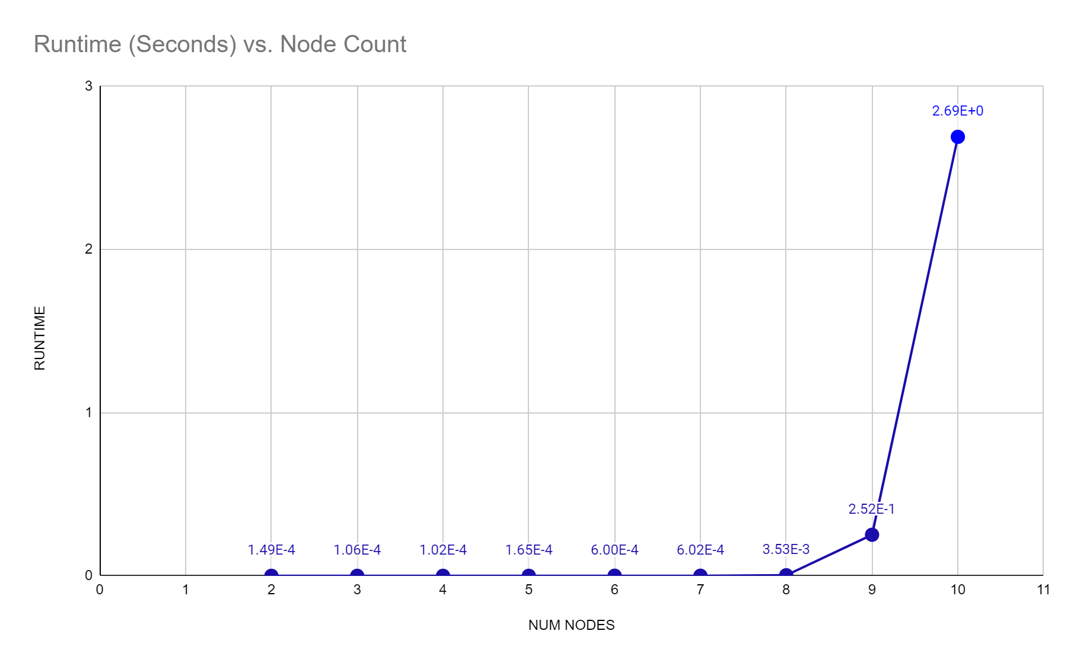
Runtime Analysis (Empirical)
NUM EDGES | NUM NODES | RUNTIME (Seconds)
1 | 2 | 0.0001490116119
3 | 3 | 0.0001063346863
4 | 4 | 0.0001018047333
5 | 5 | 0.0001647472382
6 | 6 | 0.0005996227264
7 | 7 | 0.0006020069122
8 | 8 | 0.003526210785
9 | 9 | 0.2516367435
10 | 10 | 2.690212965
11 | 11 | MEMORY ERROR

